Slide 1


“GOING ALL IN”
(LEADERSHIP AGILITY AND THE IMPORTANCE OF CULTURE)
“
Cynt Marshall
Notes:
Acknowledge my friend John
Next slide – My Career Phase 1 (lessons from each job)

Slide 2
MY CAREER PHASE 1
Lessons Learned From 15 Jobs
Take a Risk
Group Manager,
Operator Services
Try Something Different
Network Engineer
Conspire and Contribute
Recruiter
Love the People
NTEC Manager
Do the right thing
TRCO Manager
When it’s
over, Stop!
Operations Staff Director
Pay attention
to all of it
District Manager, AI & M
Transfer
Your Skills
Regulatory, Director
Prepare!
Regulatory,
Executive Director
Accept Adversity
Regulatory, VP
Never Give Up
Regulatory & Constituency
Relations, VP
Protect the Brand
Regulatory & Constituency
Relations, SVP
Be Grateful
President, AT&T North Carolina
Show Up,
Work Hard
SVP, Human Resources
Make A Difference
SVP, Human Resources & Chief Diversity Officer
Notes:
I learned from every job
Love the people – the most important lesson by 4th job
3Ls learned from a “career”
Career Phase 1 also taught me the importance of “agility”
Next slide – definition of agile

Slide 3
Ag·ile
[ˈajəl]
adjective
able to move quickly and easily
“Agility is the key to our success.”
Cynt Marshall
Notes:
AGILE for today is the “Axxess Growth Innovation and Leadership Experience”
It is also the ability to move quickly and easily
Career Phase 2 has been filled with “Opportunities to be agile”
“Agility is the key to our success” at the Mavs …on and off the court
Next slide – My career phase 2: All IN Leadership”

Slide 4
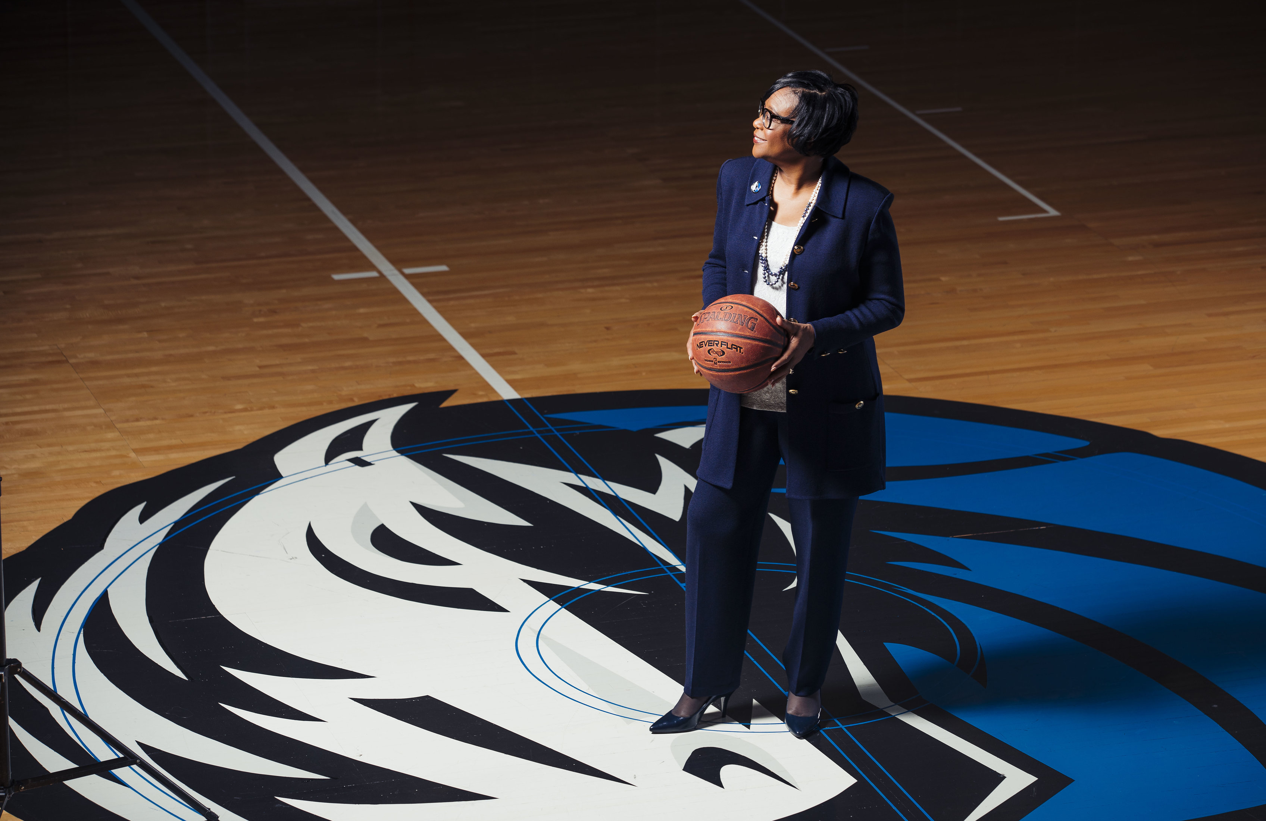





MY CAREER PHASE 2: “ALL IN” leadership
INtent
INsight
INtegrity
INspiration
INclusion
Notes:
Career phase 2 mandate started with MC request 5 years ago.
Mandate – transform the culture; quickly
Purpose – bring “ALL IN” leadership to a hurting team…lead with intent, integrity, inclusion, insight and inspiration.
ALL IN leadership is the key to building the right culture and being able to move quickly
From the beginning, it was about moving fast but with ease and care
Started with vision and a set of values
Next slide: 100-day plan

Slide 5
LEADING WITH INTENT: 100-day plan
By 2019, The Dallas Mavericks Organization is Setting The NBA Standard For Inclusion And Diversity.
Immediate Priorities
Model zero tolerance for
inappropriate behavior
Institutionalize an inclusive
and supportive culture
Develop best-in-class employee complaint process and operations infrastructure
Develop Mavs Women’s Agenda
Model Zero Tolerance
Mavs Women’s Playbook
  Investigate Allegations of Misconduct
  Analyze Results
  Respond Swiftly to Findings
  Communicate Consequences,
  as appropriate
  Executive Commitment
  Educate & Develop
  Empower & Engage
  Employ Long-Term
  Encourage & Mentor
Culture Transformation
Values Based Employment
Inclusion & Diversity Strategy Development
Mandatory Training
Employee Engagement
Our Values:
Character–Respect–Authenticity
–Fairness–Teamwork–Safety
  Customers
  “Respect In
  The Workplace”
  Leadership
  “Call to Action”
  One on Ones with Every Employee
  Reputation
  Employee Climate Survey
  Agenda for Women
  Values-Based Employment
  Unconscious
  Bias Training
  Code of Conduct
  High Trust Behaviors
  Family–home, work, community
  Inclusion Council
  Talent
  Inclusive and
  Exclusive Behaviors
  Inclusion and
  Diversity Sessions
  Operating Principles
  Suppliers
  Physical Work Environment
Operational Effectiveness
Doing Business
Compensation
Staffing
Talent Management
  People Strategy
  and Policies
  Employee Handbook
  Gender Pay Equity
  Organization Structure
  Employee Movement Process
  Operational Results
  Pay for Performance
  Exits and Backfills
  Retention
  Complaint Process
  External Advisory Council
  Market Analysis
  Job Changes
  Employee Development
  Compliance
  Workforce Demographics
  Performance Reviews
#respectatwork #perfectourcrafts
Notes:
Very intentional about our vision re: setting the D & I standard
4-part plan; 200 initiatives
Foundation was/is our values
Next slide – Our Values

Slide 6
LEADING WITH INTENT and integrity
Values
CHARACTER
#AlwaysDoTheRightThing
RESPECT
#BeNice2People
AUTHENTICITY
#DoYou
FAIRNESS
#EquityMatters
TEAMWORK
#AintNoMountainHighEnough
#perfectourcrafts
SAFETY
#NotAccidentalButIntentional
#PhysicalAndEmotional
Notes:
Values-based employment
Tell Character story
Next slide - Fairness value, gender pay equity; addressing it quickly

Slide 7

LEADING WITH INTENT
THE VALUE OF FAIRNESS
Notes:
Play the video when queued
Next slide – teamwork; DG pic

Slide 8
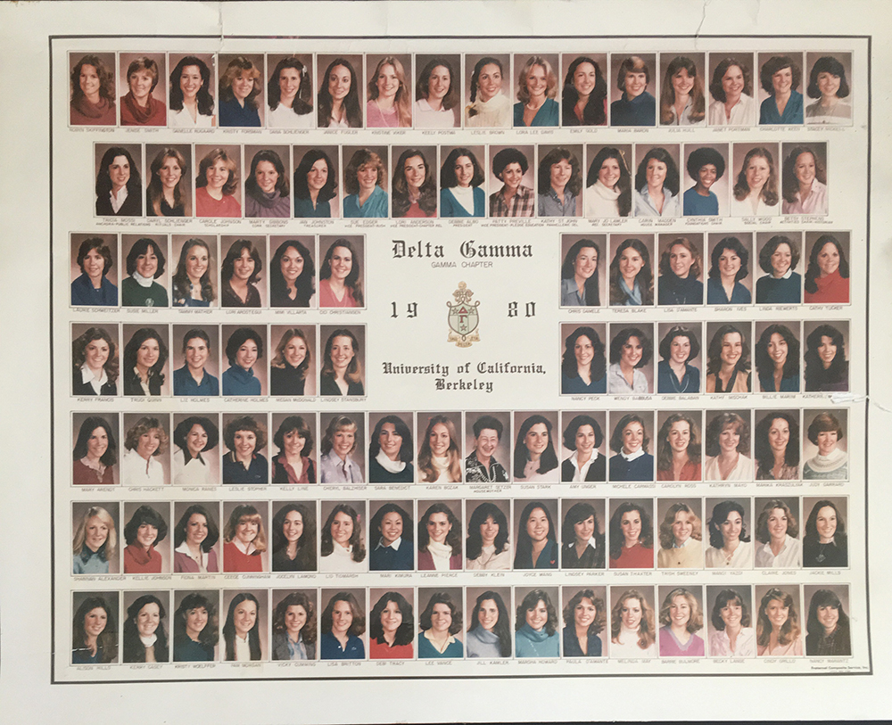
LEADING WITH INTENT
THE VALUE OF TEAMWORK
Embrace Your Sisters and Brothers
You Need Them!
Notes:
Tell DG vespers story
Queue Song, ANMHE for “ANMHE, you can count on me” exercise
Next slide – Leading with Intent: invested in our people

Slide 9












Leading with intent
Build Trust, Teamwork,
and Empowerment
Organizational Infrastructure
Employee Resource Groups
  W.O.M.E.N.
  Parents & Families
  Under 30 / < 5 years service
  Black Employees Network
Market-Based Compensation
Staffing and Structural Changes
Leadership Training
Mentors and Coaches
Employee Development
and Retention
Create Supportive
Communities
Organization Business Plan and Goals
Professional Counselors
Inclusion and
Compliance Councils
Diversity & Inclusion Strategy
Invest in Your People
Notes:
We invested in our people
Diversity & Inclusion CRAFTS strategy was center-court
Next slide: Leading with Inclusion – difference between diversity and inclusion

Slide 10




Leading with inclusion
Diversity
Inclusion
Diversity is a mix of our unique backgrounds
and differentiating dimensions
Inclusion is behavior that promotes and sustains
a culture that understands, welcomes and caters
to our differences
Diversity provides the ingredients for success
Inclusion is the recipe for success
Diversity encourages presence
Inclusion insists on participation
Diversity counts the numbers
Inclusion makes the numbers count
Diversity
is being invited to the party.
Inclusion
is being asked to dance.
Notes:
Talk differences
Dance lesson ; PLAY SONG: Cupid Shuffle when queued
Next slide – Leading with “Insight” – equality and equity difference

Slide 11
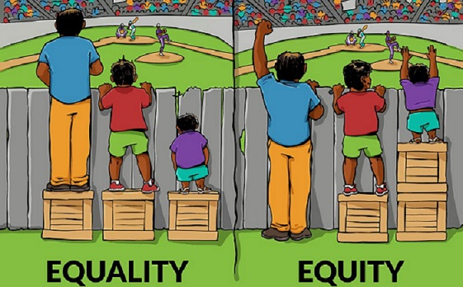
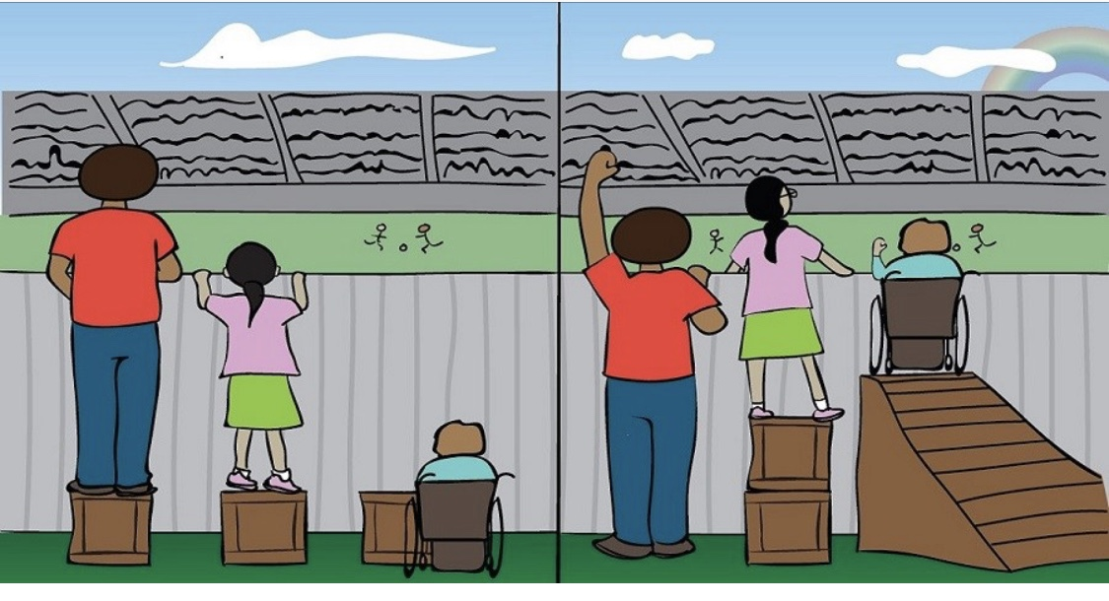
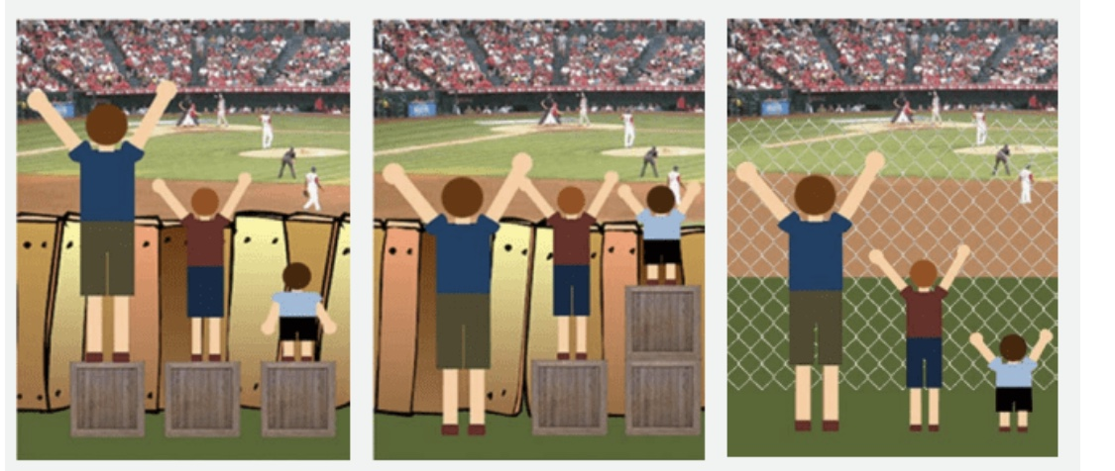
LEADING WITH INSIGHT
EQUALITY & EQUITY
Equality
Equity
What happened here?
What’s different?
GIVE THEM WHAT THEY NEED
Notes:
Need 3 volunteers
Next slide – Leading with Insight: Perspectives (6/9/g)

Slide 12
Leading with insight
PERSPECTIVES
Just because you are right, does not mean I am wrong.
You just haven’t seen life from
my side.
SIX
NINE
“
6
“
Notes:
Audience participation
Next slide – Leading with inspiration: Summer of 2020 Courageous Conversation

Slide 13
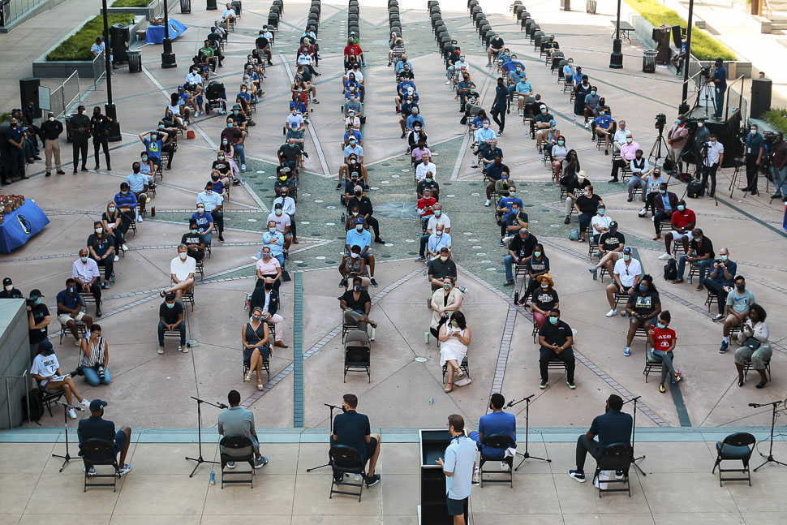
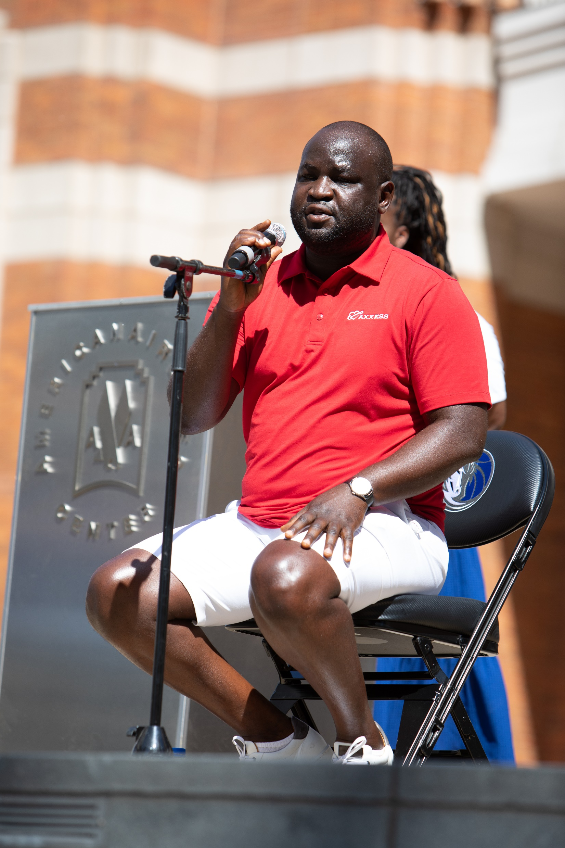
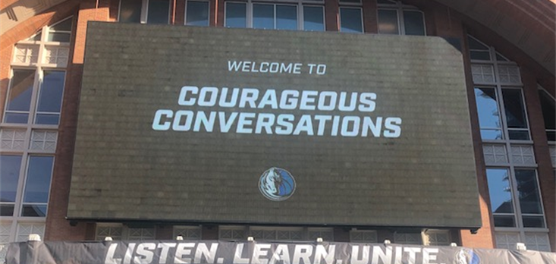
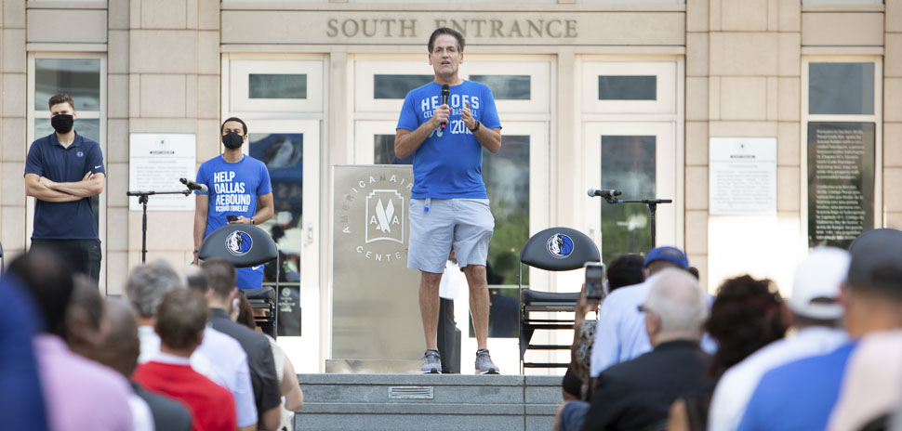
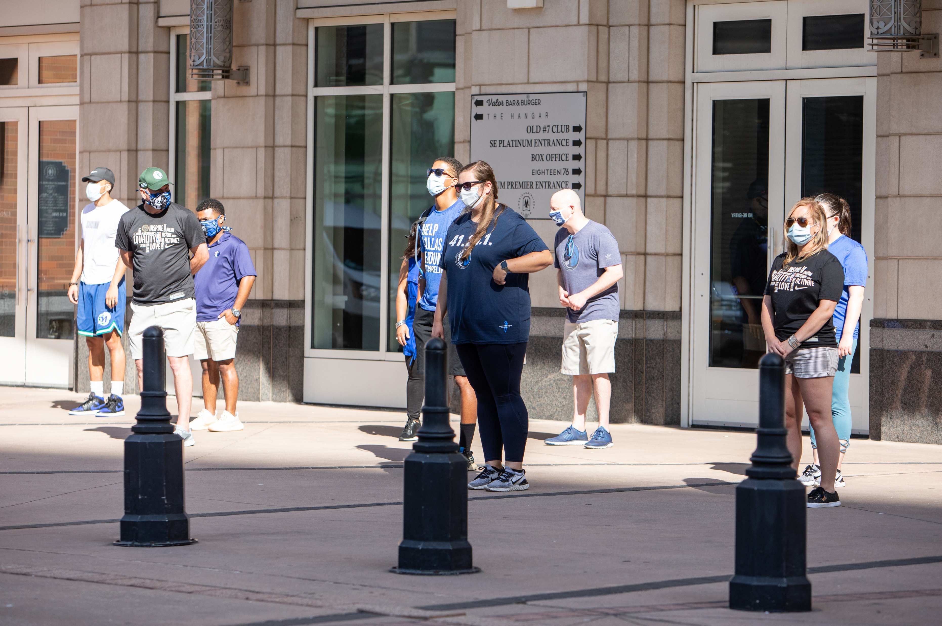

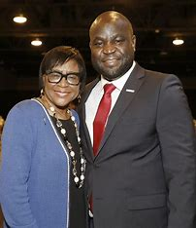
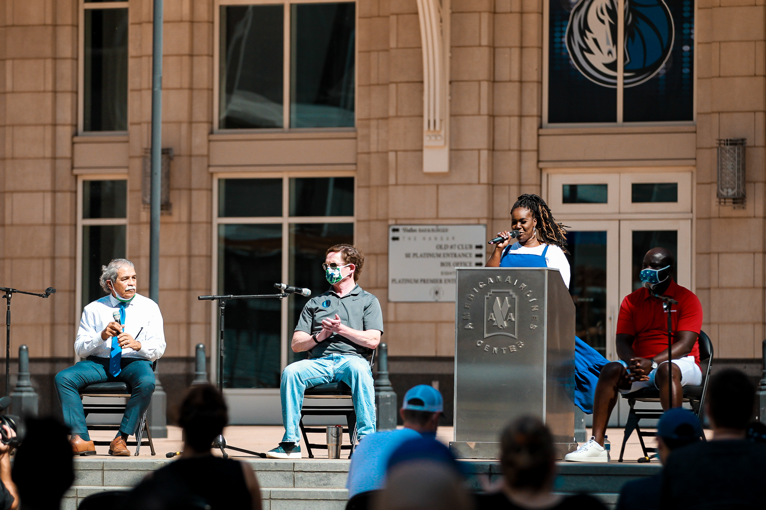
leading with inspiration & AGILITY: summer of 2020
Notes:
“Agility Opportunity” to work with John
Courage to convene a candid conversation to discuss inequality and inequity
Courage to talk about it and lead
Listen…learn…unite
John and I are partnered to take action; and now we are working to turn action into traction (DRC DEI and Mavs Take ACTION!)
Next (final) slide – “Are you all in?”

Slide 14

ARE YOU ALL IN?
INtent
INtegrity
INclusion
INsight
INspiration
QUESTIONS TO THINK ABOUT IN DEVELOPING YOUR “ALL IN” LEADERSHIP PLAN
What will you be intentional about?
How will you model good character?
How will you foster inclusion?
What insight do you need from others?
Where will you look for inspiration? What’s your purpose?
How will you make the vision, values and plan clear?
Are you going to do the right thing or just do things right?
Who will you teach to dance?
How will you ensure that every voice matters?
How will you inspire others?
Notes:
SONG: “We can work it out” by The Beatles to reflect on the questions that Cynt will ask
Ask questions on slide while song is softly playing
If you’re ALL IN…focused on purpose, people, community…leadership agility and culture
Find 3 people and tell them, “I’m ALL IN!”

